Slide 1
PHYSICS PROJECT
AUTOMATIC SANITIZER DISPENSER
AND
AUTOMATIC WATER DISPENSER

Slide 2
Members of the group
120A3011-Kirti Ekhande
120A3020-Esakkiraja Konar
120A3033-Nishita Swaminathan
120A3040-Ankur Rai
120A3052-Shreyas Prabhakar

Slide 3
SENSORS
It can be called as an electronic component which is capable of detecting changes in its environment and send the information to the coupled relay or a microprocessor.
We see the usage of sensors in our daily life.
From the reverse car parking sensors in our automobile to the touch sensitive sensors that are used in the smart phones. A sensor basically works on the change in the input quantity being measured.
A sensor's sensitivity indicates how much the sensor's output changes when the input quantity being measured changes. For instance if we consider infrared sensor, it is triggered only when an object cuts the line of the infrared beam.

Slide 4
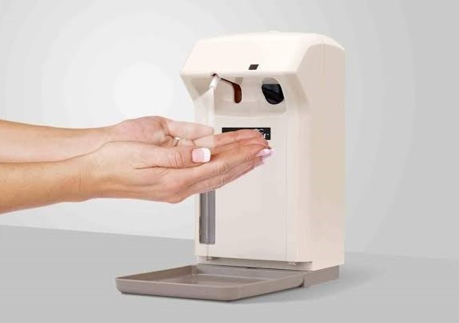
Automatic Sanitizer Dispenser

Slide 5
Reason for selecting this as one of our topic for our project:-
Cleanliness is next to Godliness. Sanitizing is one of the best methods of keeping ourselves and our surroundings hygienic. During this pandemic, sanitization has taken a very important role in our lives.

Slide 6
Advantages of automatic sanitizer DISPENSER
One of the biggest advantages of an automatic hand sanitizer dispenser machine is that it offers a required amount that is enough to clean both hands.These required doses are usually sprayed on the hands, which causes minimum to no wastage, unlike manual ones, which releases extra sanitizer at times.
Eliminates a contact point
Manual hand sanitizers require pushing the pump to release sanitizer.Touching the pump can spread a lot of germs, as people with dirty hands also use it.
With touchless hand sanitizer dispensers, there is no common contact point, which means less or no germs will be transferred from one person to another.

Slide 7
Components
.
COMPONENT | COST
Proximity Sensor | 90/-
DC Water Pump | 45/-
TIP32C PNP Transistor | 15/-
Aquarium Tubing | 130/-
Old Glass Jar | ---
Old Ball Pen | ---
Sanitizer/Liquid Soap | 100/-
TOTAL COST | 380/-

Slide 8
WORKINg
The proximity sensor senses the hand and the dc pump ejects the alcohol/liquid soap.
It works on power supply.

Slide 9
CONCLUSION
Alcohol hand sanitizers are much more effective than than soaps, and also easy to use .
Non contact dispensing is again important to prevent pathogens and viruses from spreading and finally hand hygiene is most important and must be a part of our daily life.

Slide 10
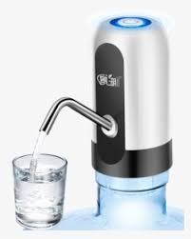
Automatic Water Dispenser

Slide 11
Reason for selecting this as our second topic of the day:-
If your tap dripped a drop of water once every second it would take about five hours for you to waste one gallon of water, that is enough water for an average human to survive for two days.
So what can be done to stop this? As always the answer, for this, lies with improvement in technology.
If we replace all the manual taps with a smart one that opens and closes on its own automatically, not only we can save water but also have a healthier lifestyle since we don’t have to operate the tap with our hands.
So in this project we will build an Automatic Water Dispenser using Arduino and an air pump that can automatically give you water when a glass is placed under it.

Slide 12
Advantages of Automatic Water Dispenser
Automatic dispensers require no plumbing.
Size- they are for easy storing and are portable.
There is minimal installation.
Cleanup is very simple.
The only thing you really have to do is replace the parts when needed.
It is easily operational.

Slide 13
Components
.
COMPONENT | COST
Aurduino Nano | 215/-
Relay | 65/-
Ultrasonic Sensor | 125/-
Wires | 200/-
Air Pump | 150/-
TOTAL COST | 755/-

Slide 14
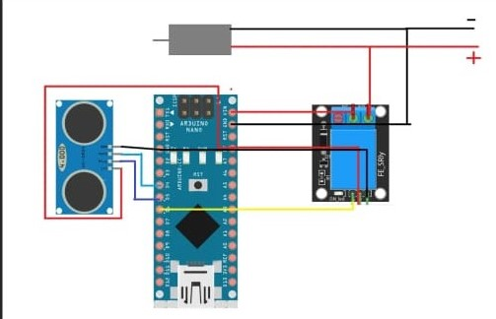
Working
The Concept behind the Automatic Water Dispenser is very simple.
An Ultrasonic Sensor is used to check if any object such as a glass is placed under the dispenser.
An Air Pump is used to control the flow of water.
So an Arduino program is written which always checks if any object is placed under the tap.

Slide 15
conclusion
The automatic water dispenser eliminates the water spillage and is more hygienic as it eliminates the human touch from the process.
Because of its efficiency, this machine can be a great alternative to public water podium stands.

Slide 16


